Slide 1
Leo Clubs
Are the future of Humanity!

Slide 2
Leo Club Objective
To provide the youth of the world with an opportunity for development and contribution, individually and collectively, as responsible members of the local, national and international community.

Slide 3
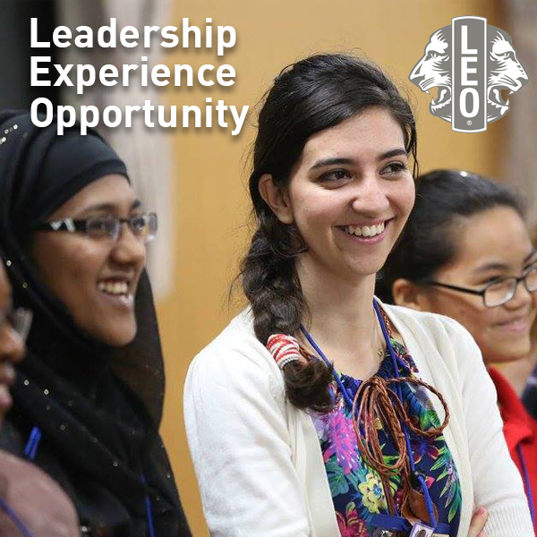
Leo Club Motto
Leadership – Develop skills as a project organizer, time manager and team leader. Experience – Learn how teamwork, cooperation and collaboration can bring exciting changes to your community and the world. Opportunity – Make friends and feel the rewards of community service.

Slide 4
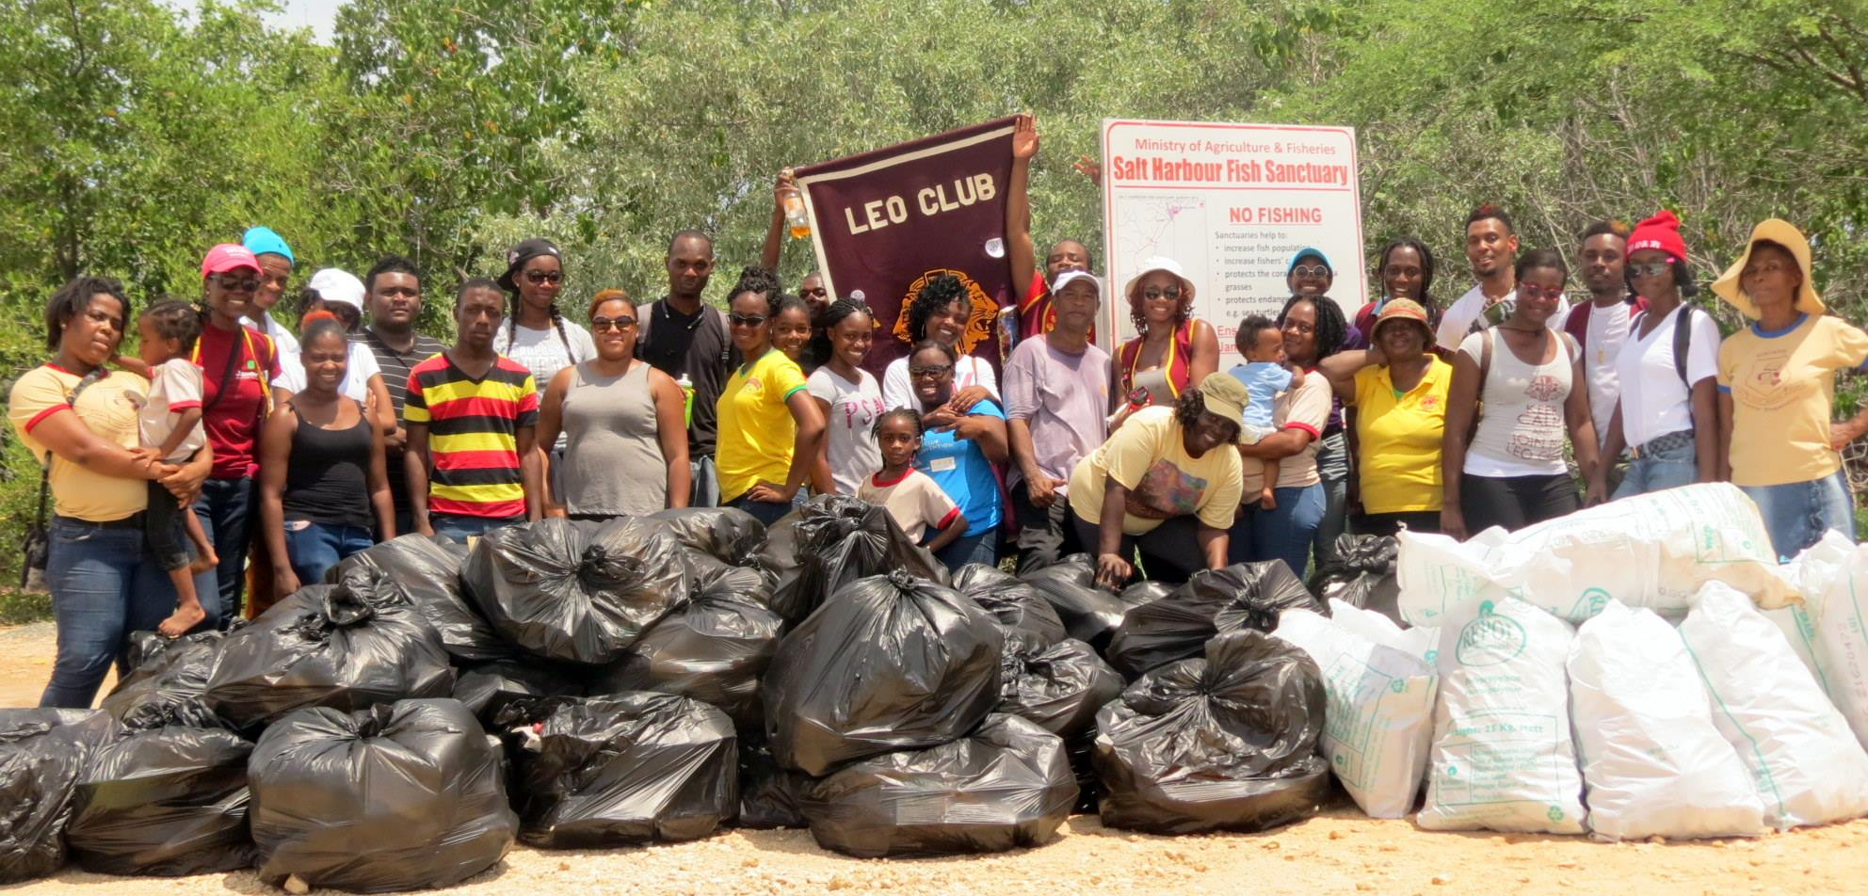
Community Service
Clarendon Leo Club (Jamaica) collected over 600 pounds of garbage during a beach clean-up
Leo clubs make local communities better places to live through a diverse array of community service projects. The following steps will guide Leo clubs and help young leaders make a meaningful impact within their communities.

Slide 5
Planning Service Activities
Leo Clubs help teach our youth to
Identify a Community Need: Use the community needs assessment to determine your next project and assess which services are needed in your community.
Contact other Community Organizations: Successful projects often involve collaboration with other partners. Connect with other organizations and seek potential partnerships for greater impact.
Calculate Costs: Assess the current financial and membership resources within your club. If necessary, consider creating a joint project with another Leo club or with your sponsoring Lions club.
Establish a Timeline and Measurable Goals: Determine your project goals - what do you hope to achieve and when do you hope to achieve it.
Create a Work Plan: Develop a strategy for achieving your project's goals. Outline tasks and responsibilities to ensure success.
Publicize the Project: Inform the media about the project. Submit details about the activity to local newspapers, radio stations and television stations in advance.
LCICon 2016 - The Leo Way Seminar

Slide 6
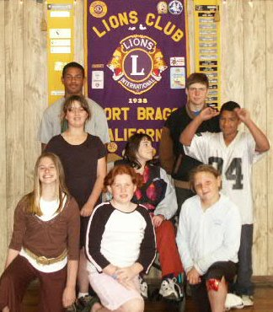
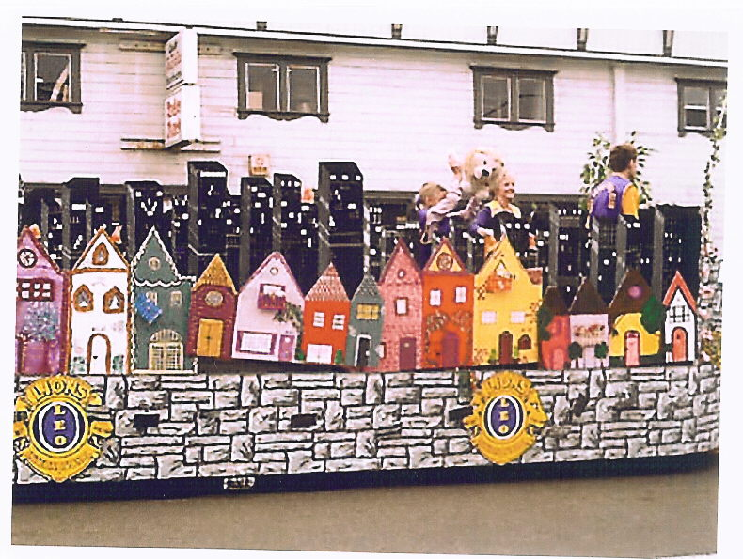
FORT BRAGG LEO CLUB 2006
The Fort Bragg Leo Club was established in 2006. Their first project was to increase awareness of their club. They built a parade float for the Paul Bunyan Days Parade. They got FIRST PLACE and received $500

Slide 7
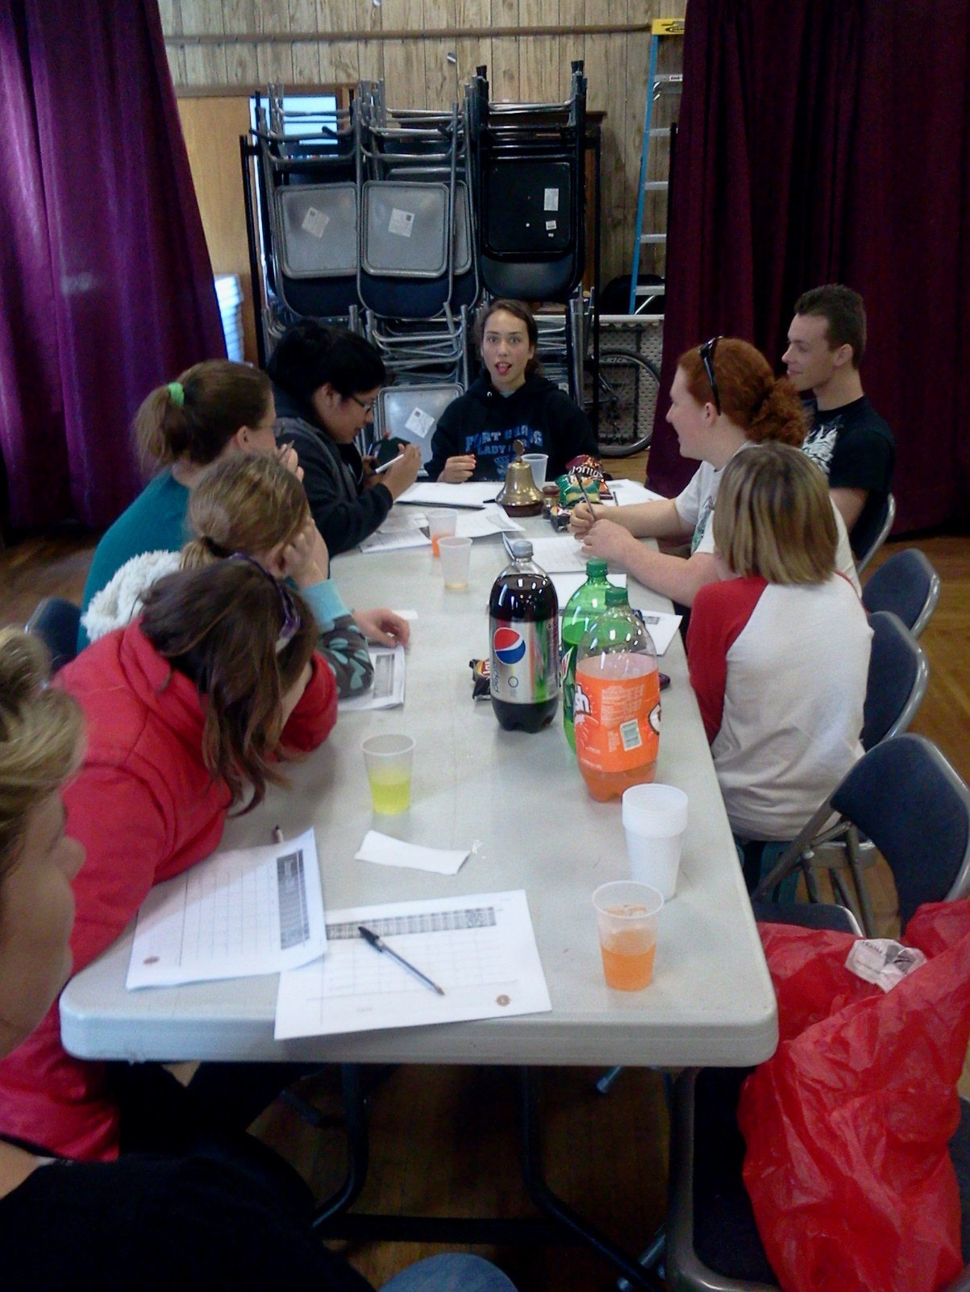
The Fort Bragg Leos learning Leadership Skills

Slide 8
The Fort Bragg Leo Club adopted the Lions for Sight Program
The Fort Bragg Leo Club sort, count, pack and deliver used eyeglasses to the warehouse, as well as pay the annual dues on behalf of the Fort Bragg-Mendocino Lions Club

Slide 9
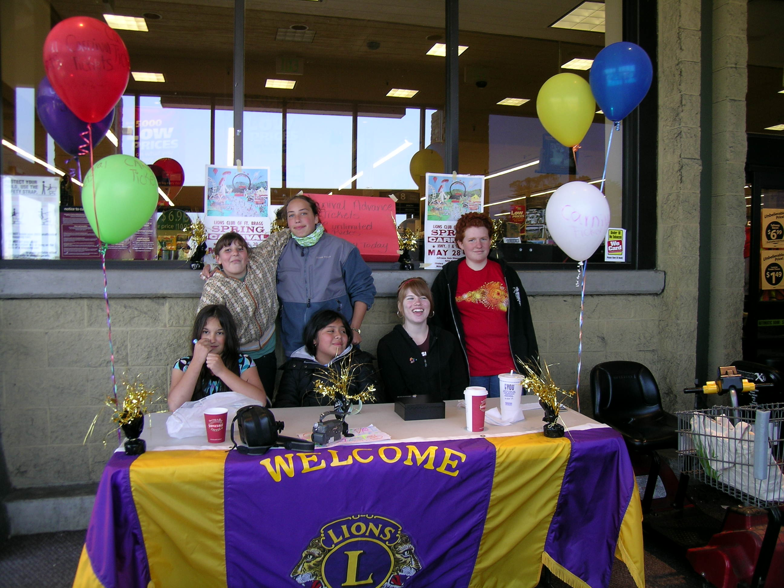
Fort Bragg Leos helping the Lions sell Carnival Tickets

Slide 10
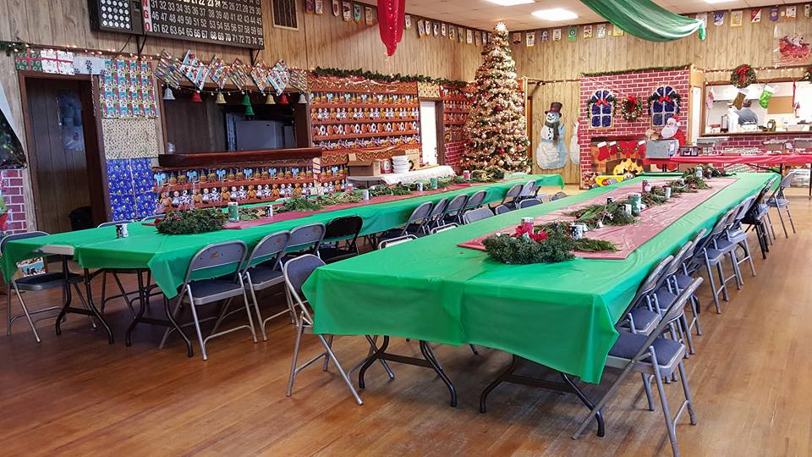
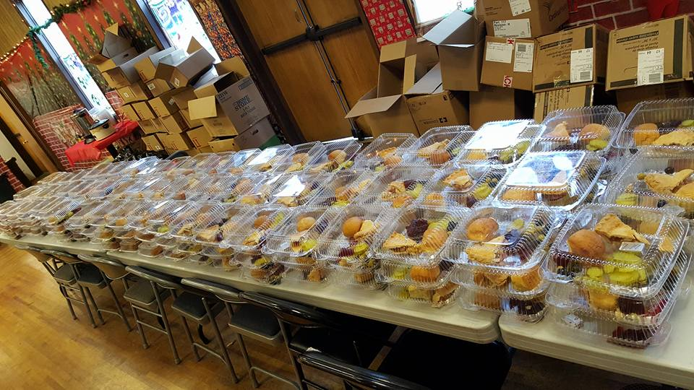
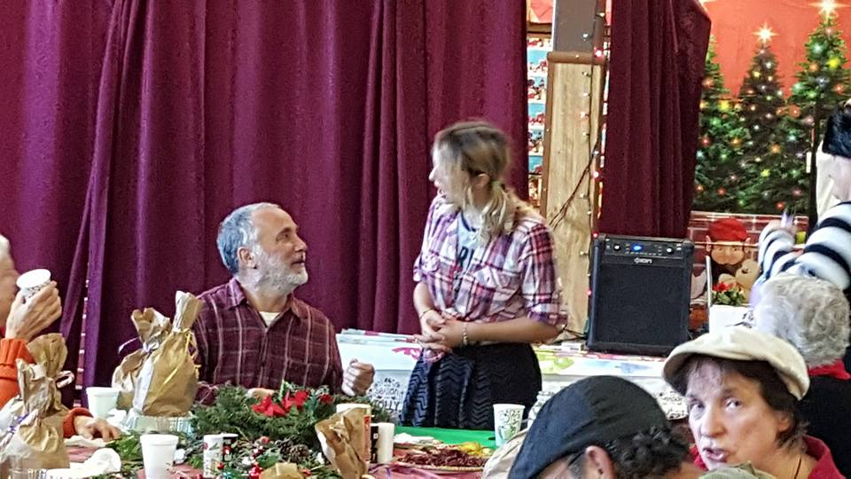
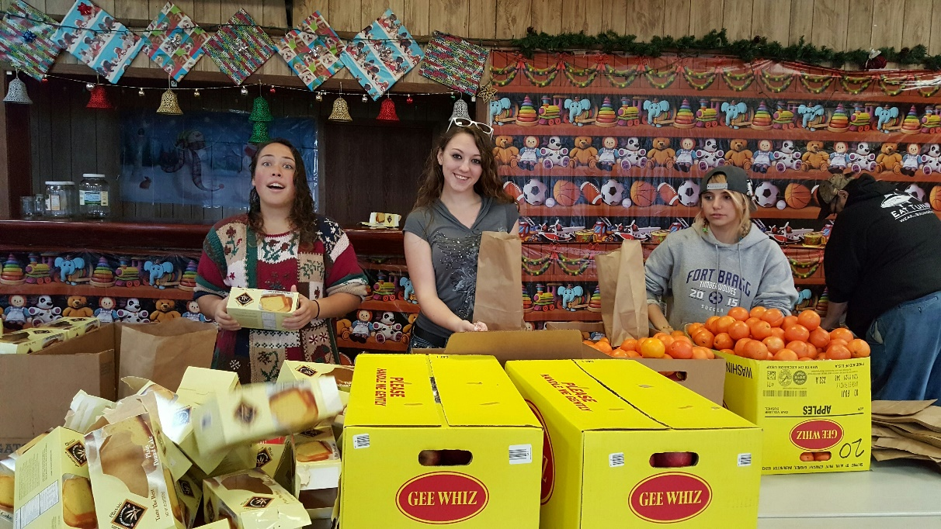
Fort Bragg Leos help the Lions with their Annual Senior Christmas Dinner

Slide 11
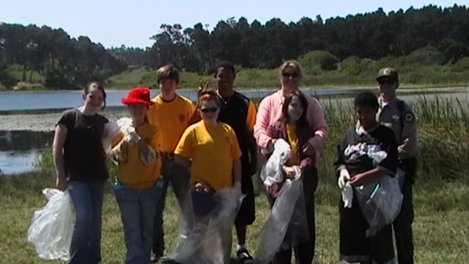
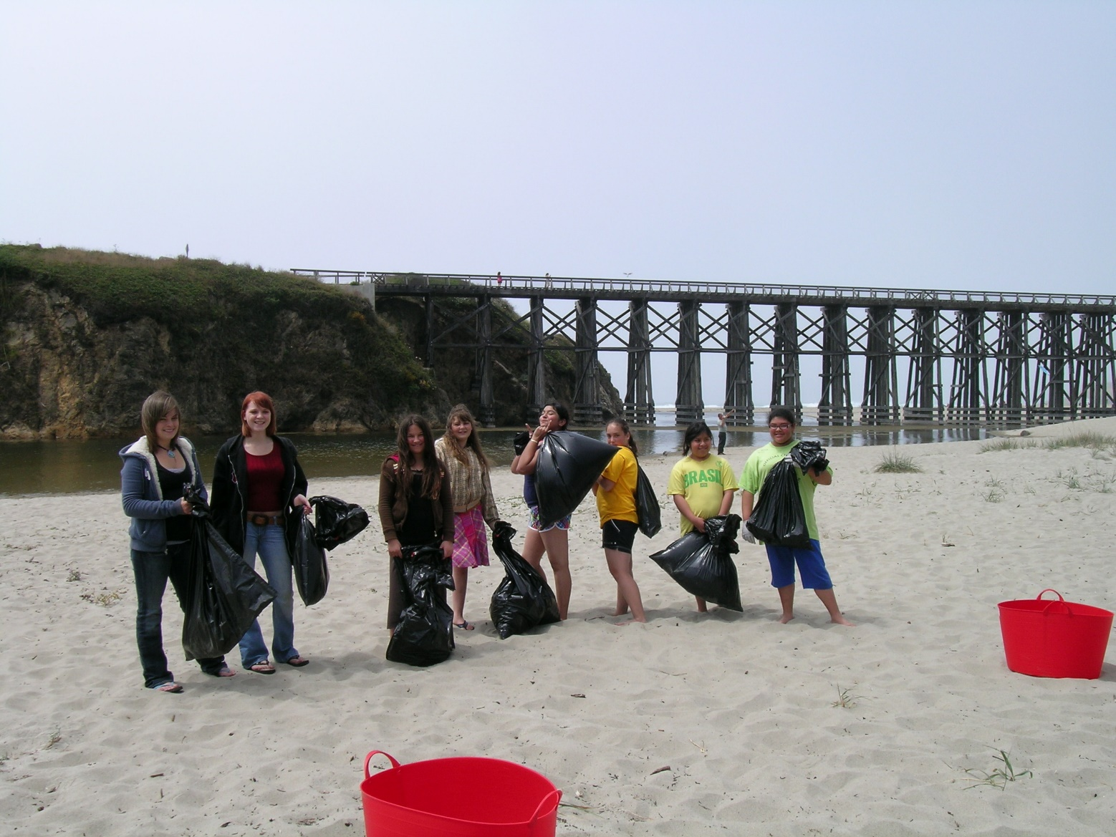
Fort Bragg Leo Annual Clean the Beach Day!

Slide 12
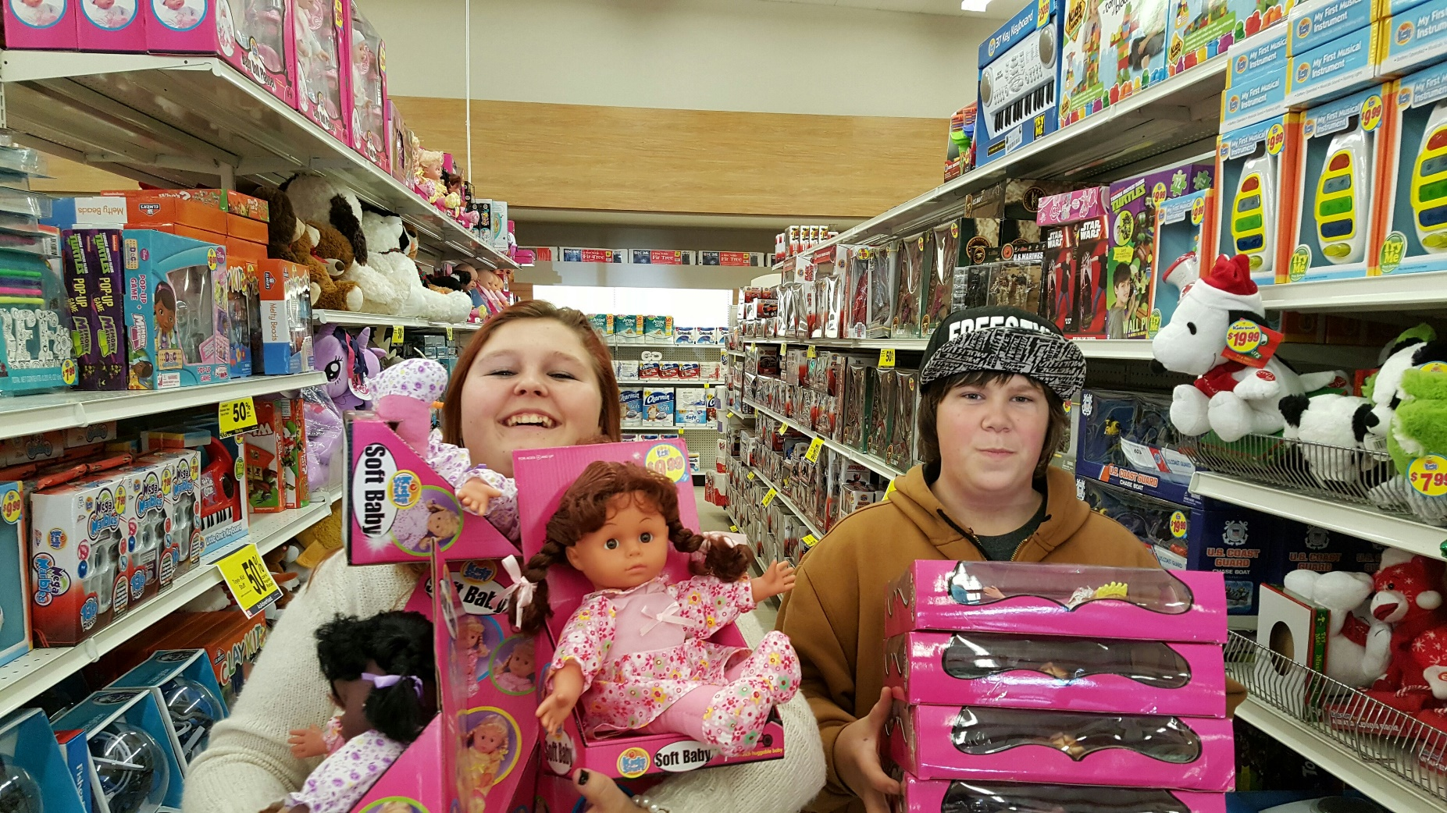
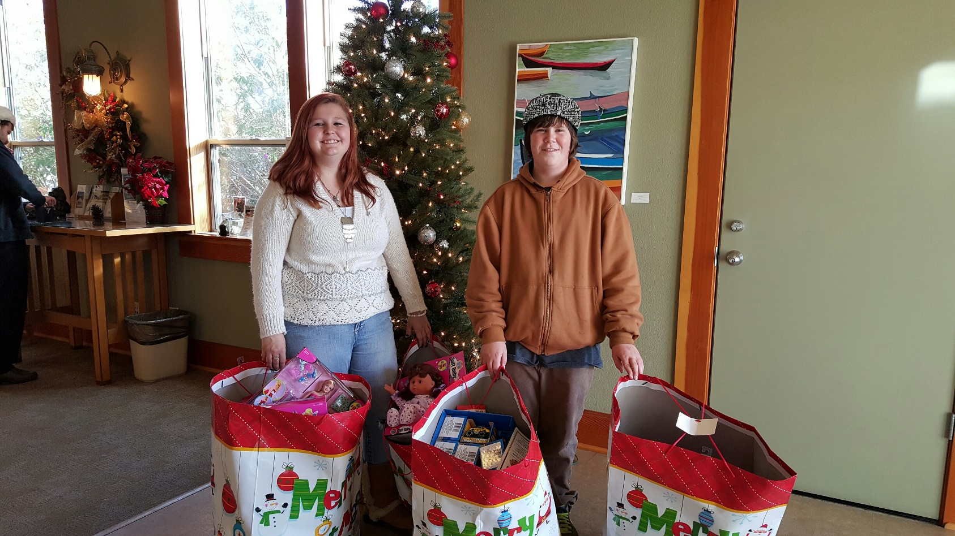
The Fort Bragg Leos got word that over 100 gift cards were stolen – gifts for children in the community
They immediately took action and purchased $500 worth of toys for kids

Slide 13
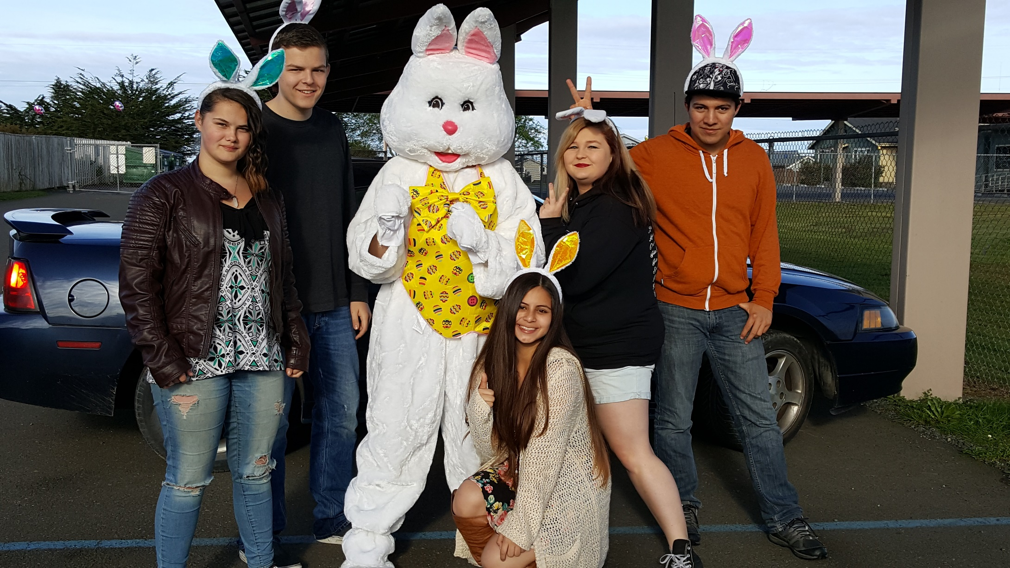
The Fort Bragg Leos now provide a FREE Easter Egg Hunt!

Slide 14
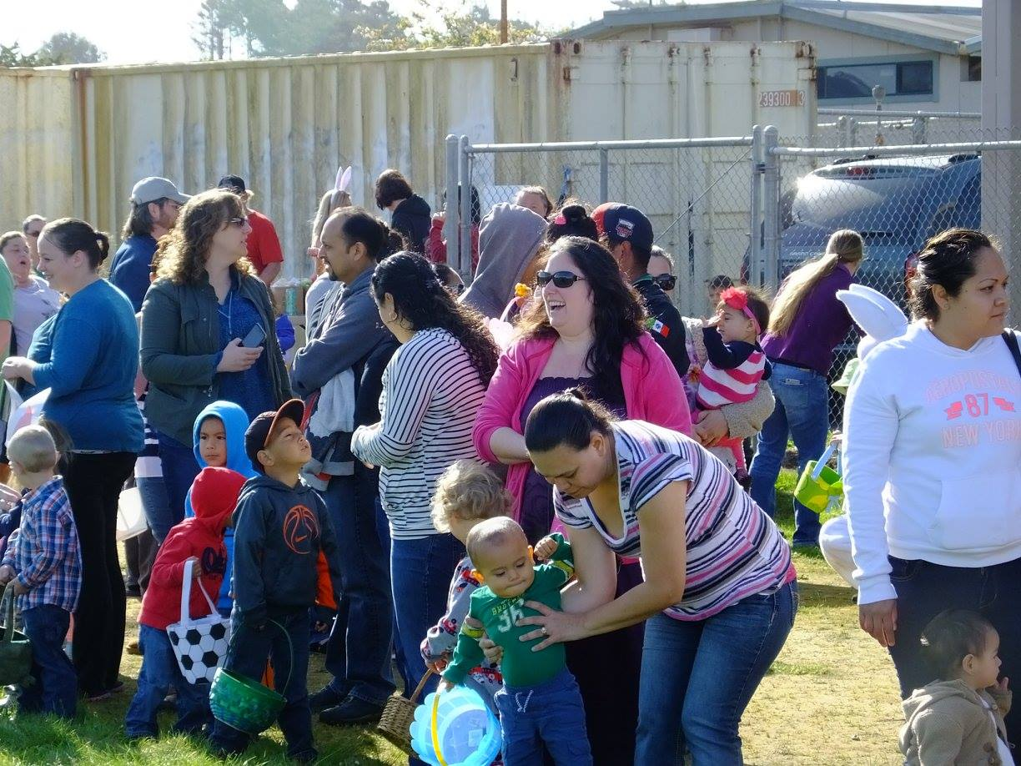
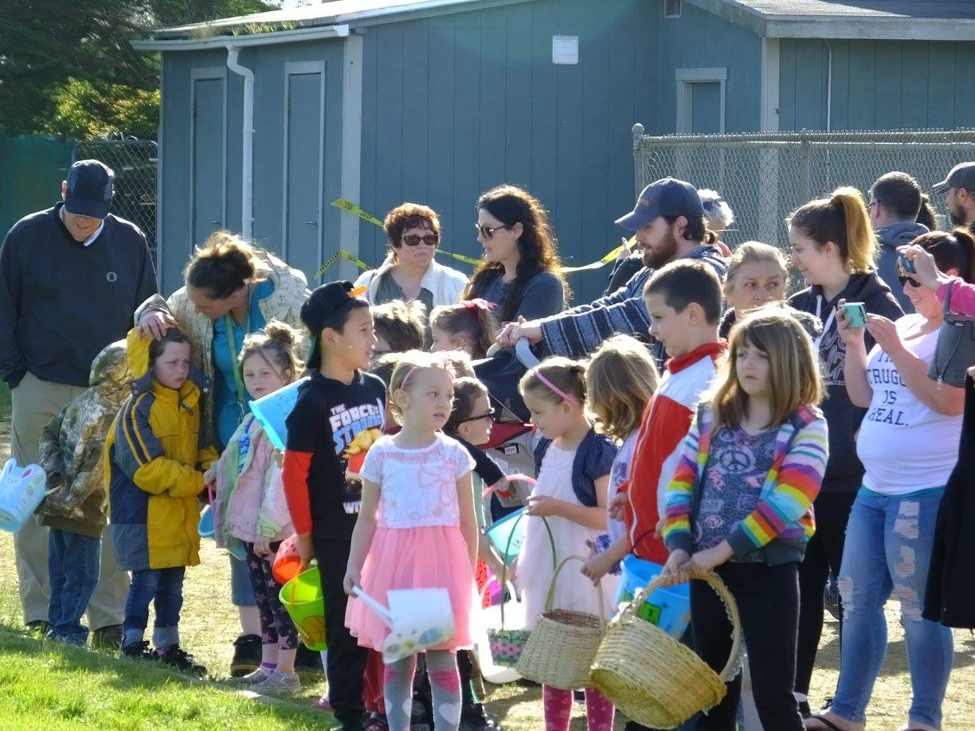

Slide 15
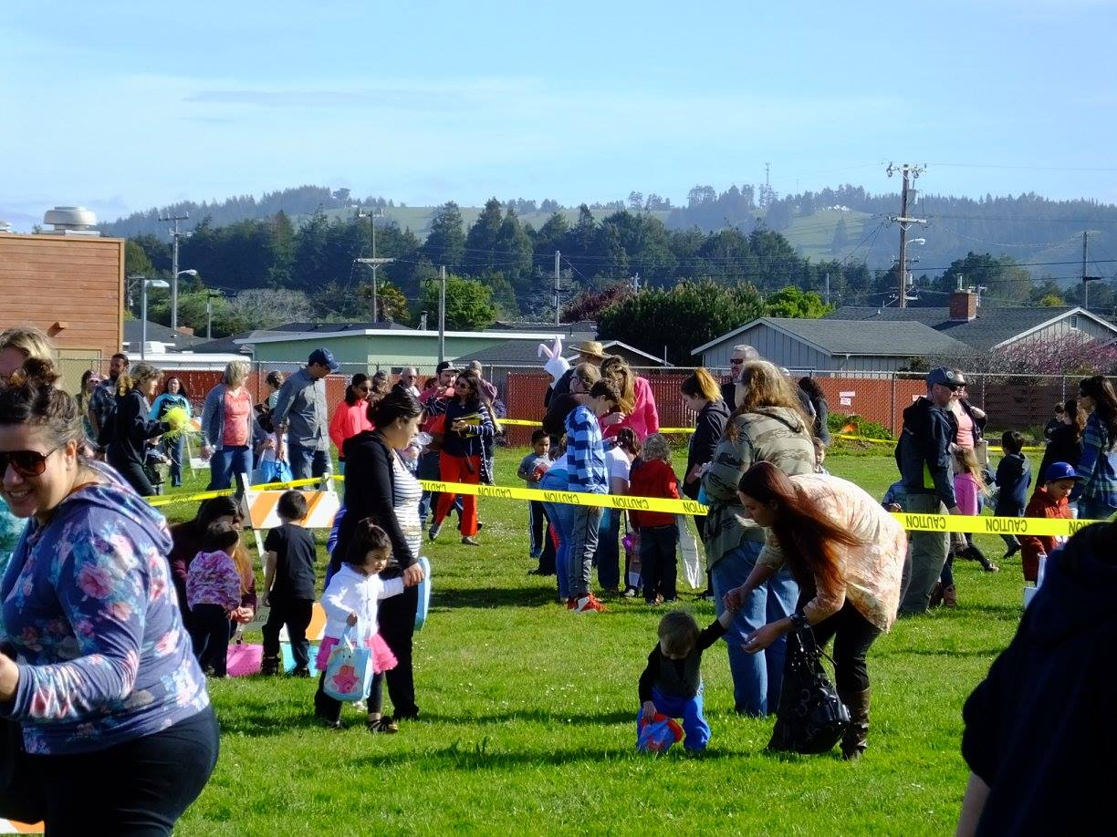
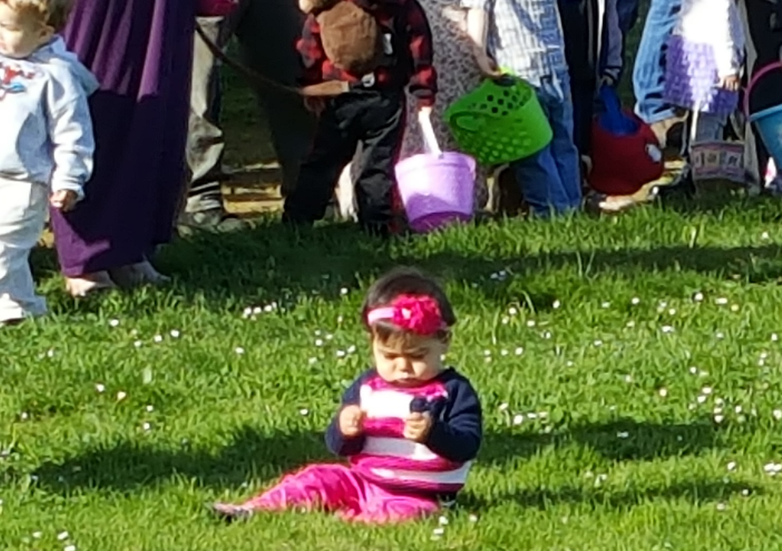

Slide 16
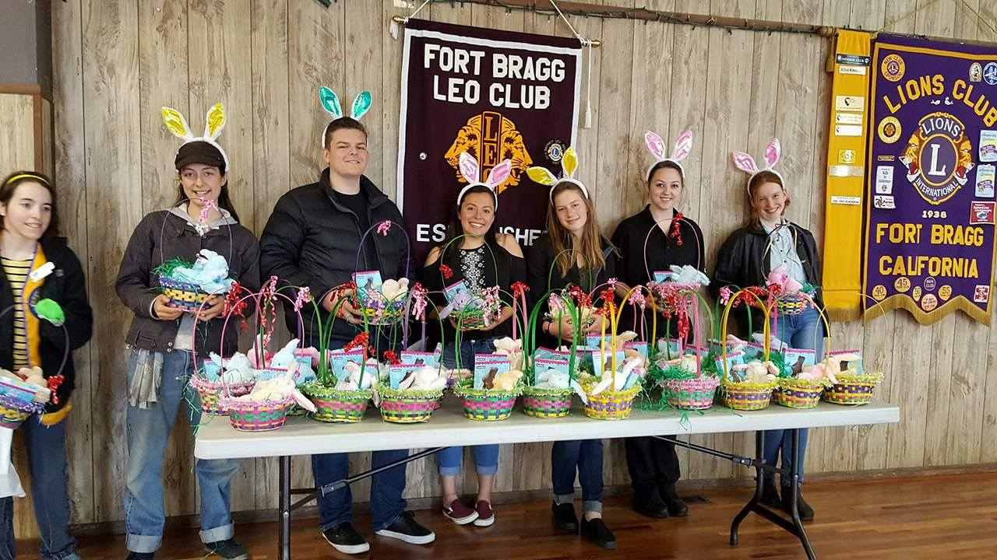

Slide 17
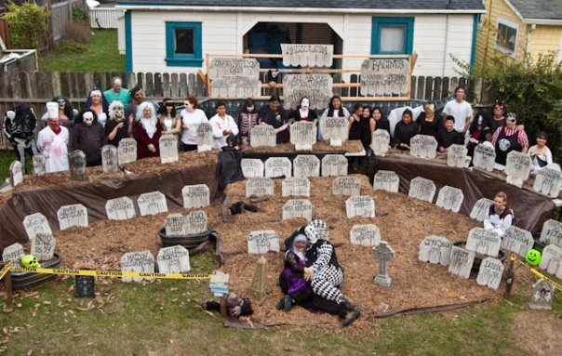
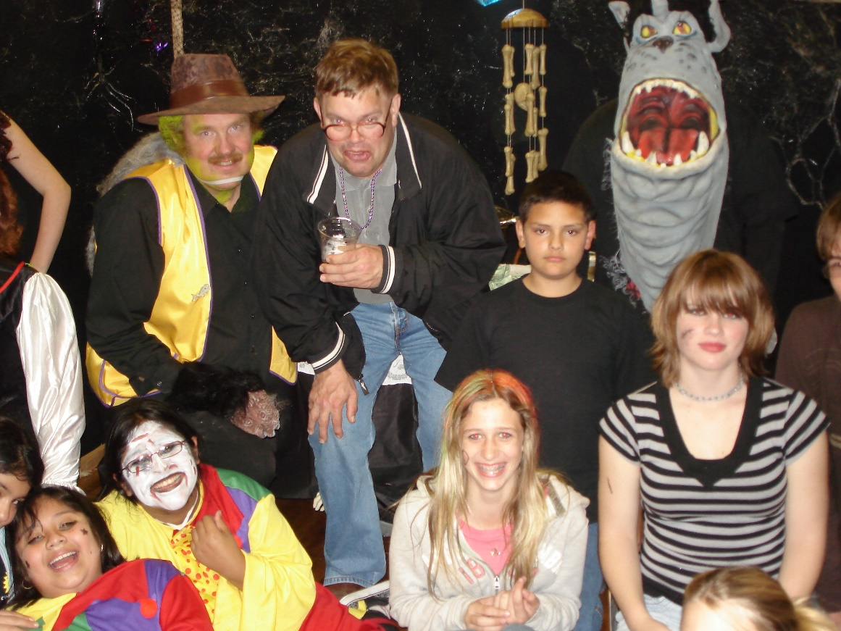
The FORT BRAGG LEO HAUNTED HALL OF HORRORS!
The Fort Bragg Leos wanted to do something other than trick or treat for Halloween. Their first haunted house was 1 night – Halloween.

Slide 18
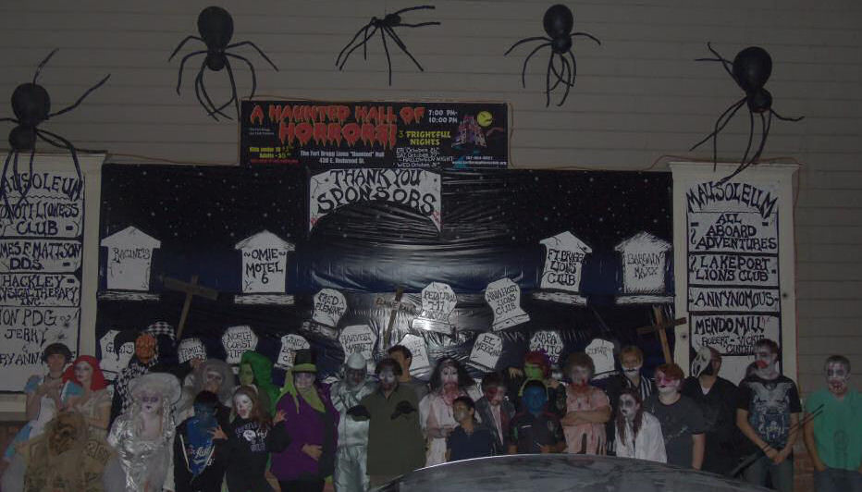
Open for 3 nights! $6,500 raised

Slide 19
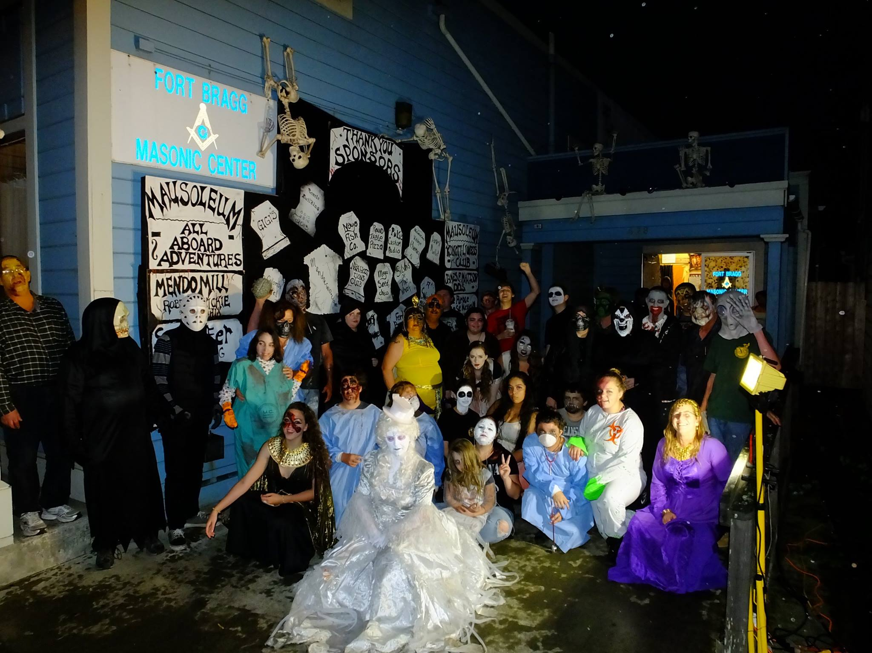
Open for 4 nights! $13,000 Raised

Slide 20
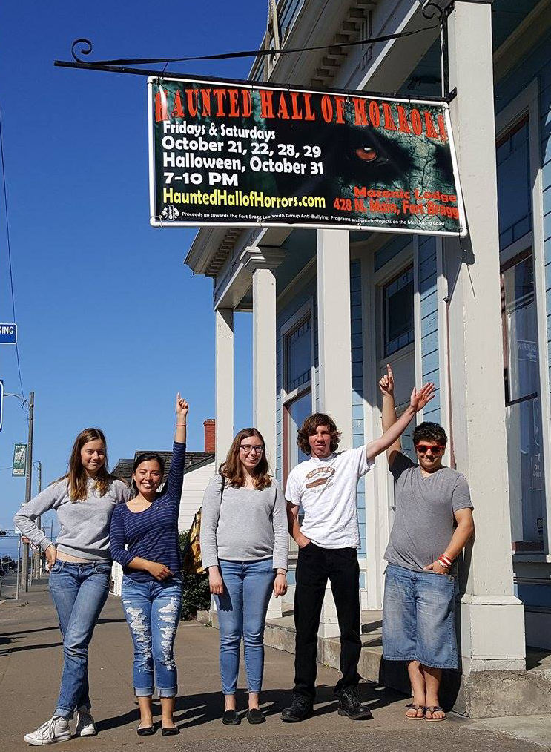
The Fort Bragg Leo’s are now a member of the West Coast Haunters Association and their Haunted Hall of Horrors is now listed as a Professional Haunted House in the USA. In 2016, their Haunted House had 65 cast and crew members and over the past 10 years raised over $56,000 to donate to Anti-bullying programs, and the Shriners Hospital for Children

Slide 21
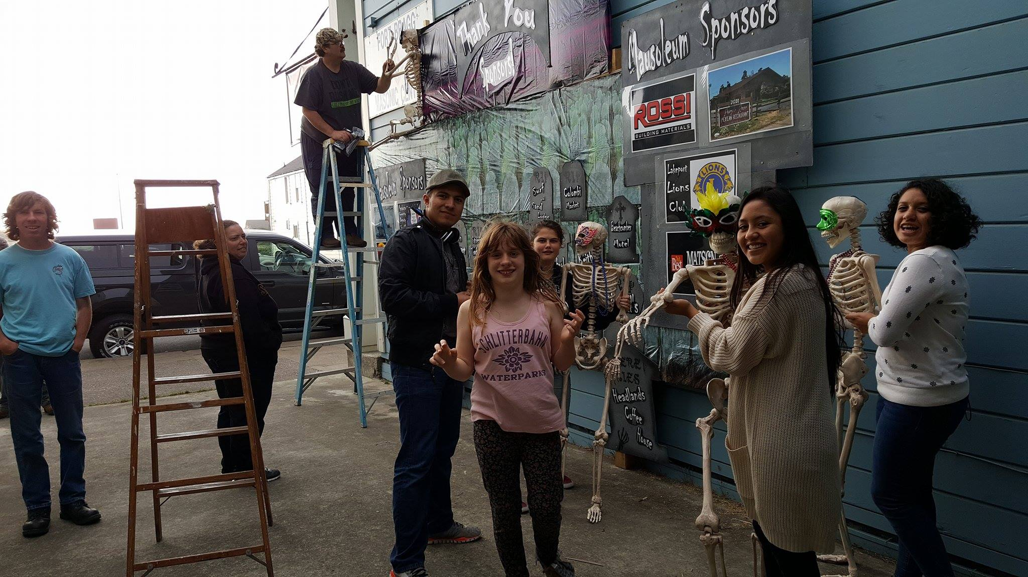
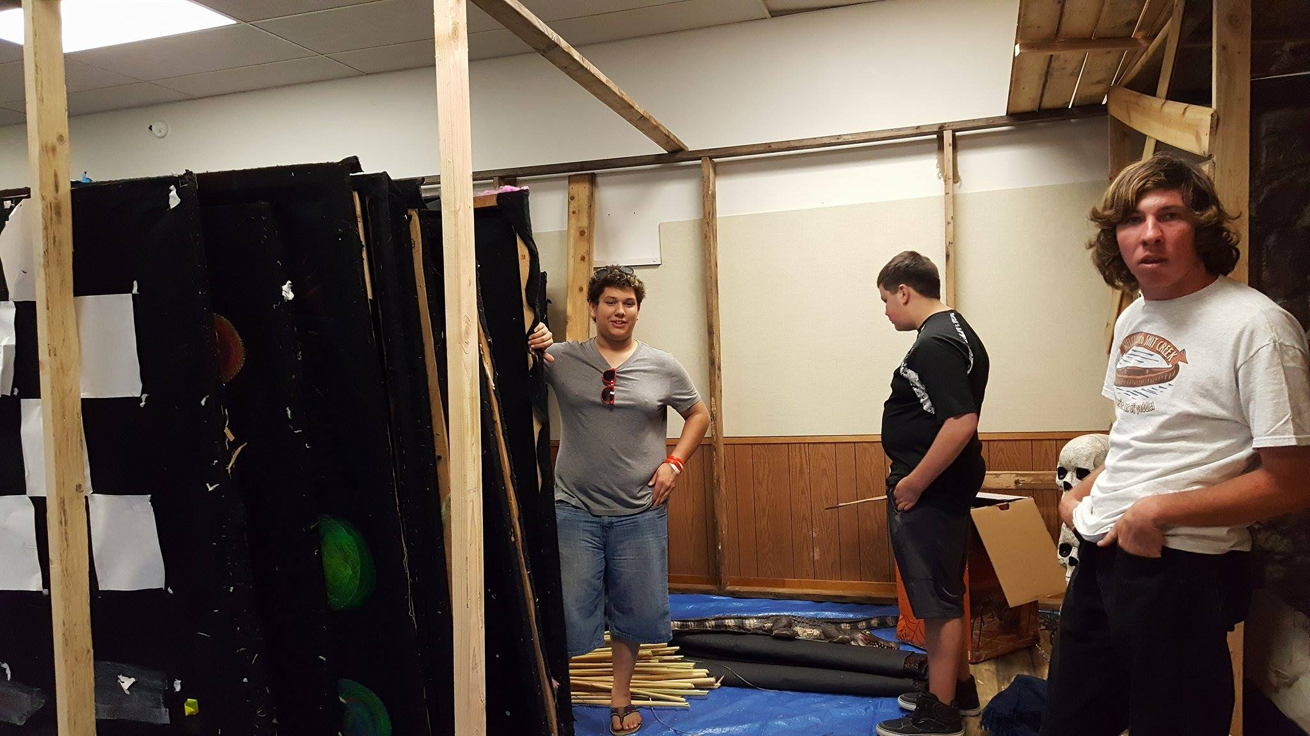
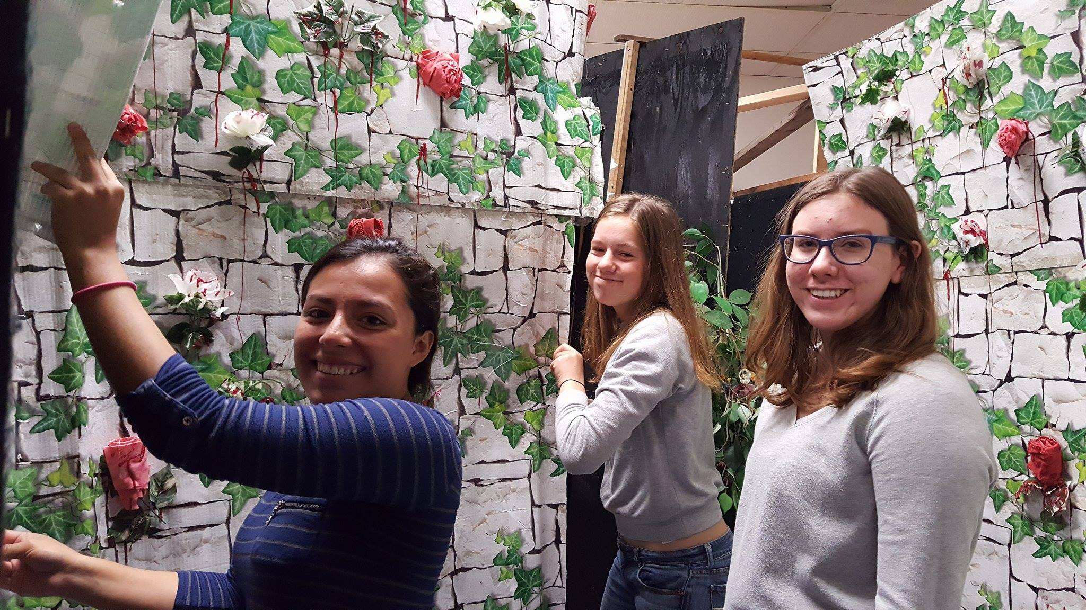
Learning team building skills

Slide 22
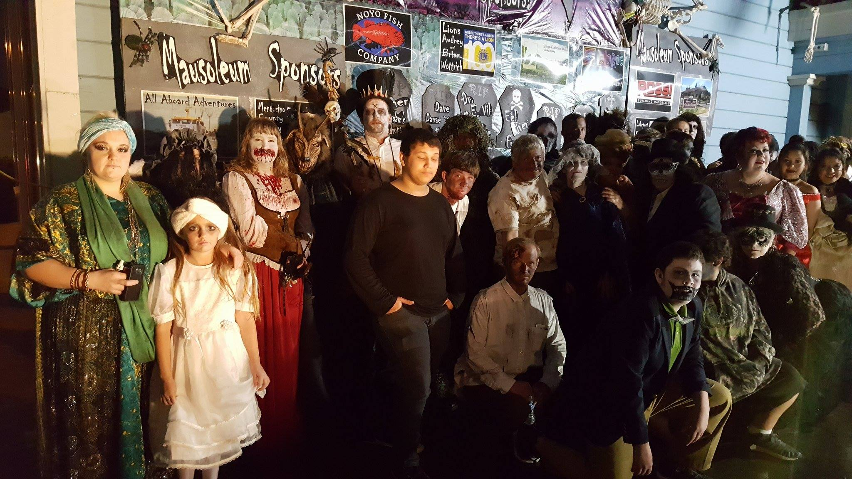
2016 open 5 nights! $14,300 Raised

Slide 23
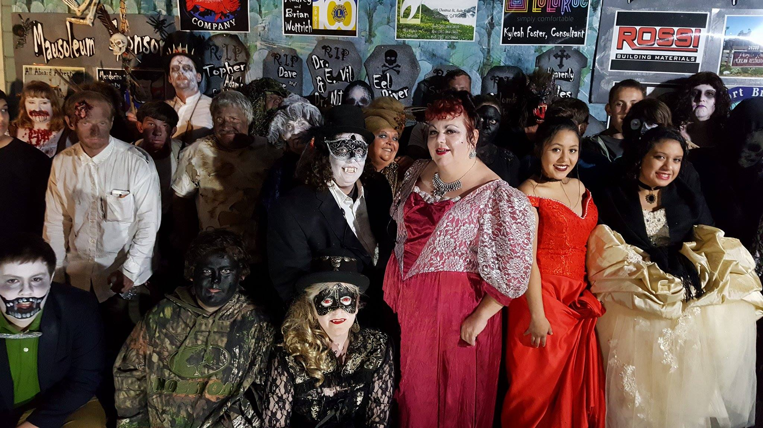

Slide 24
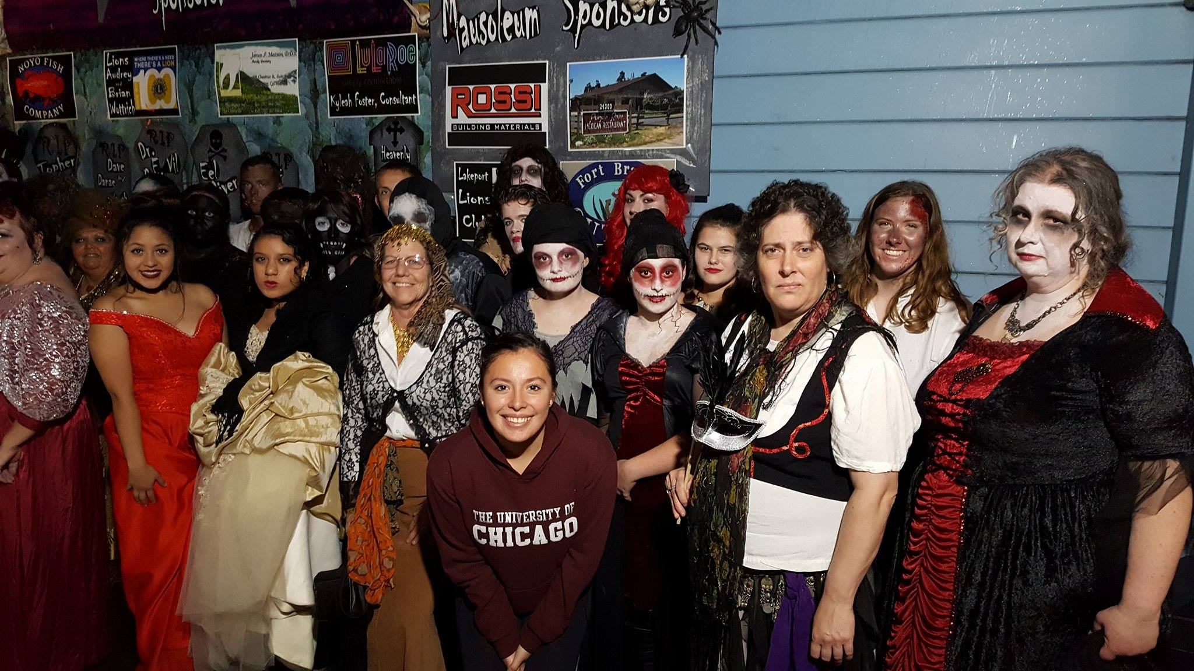

Slide 25
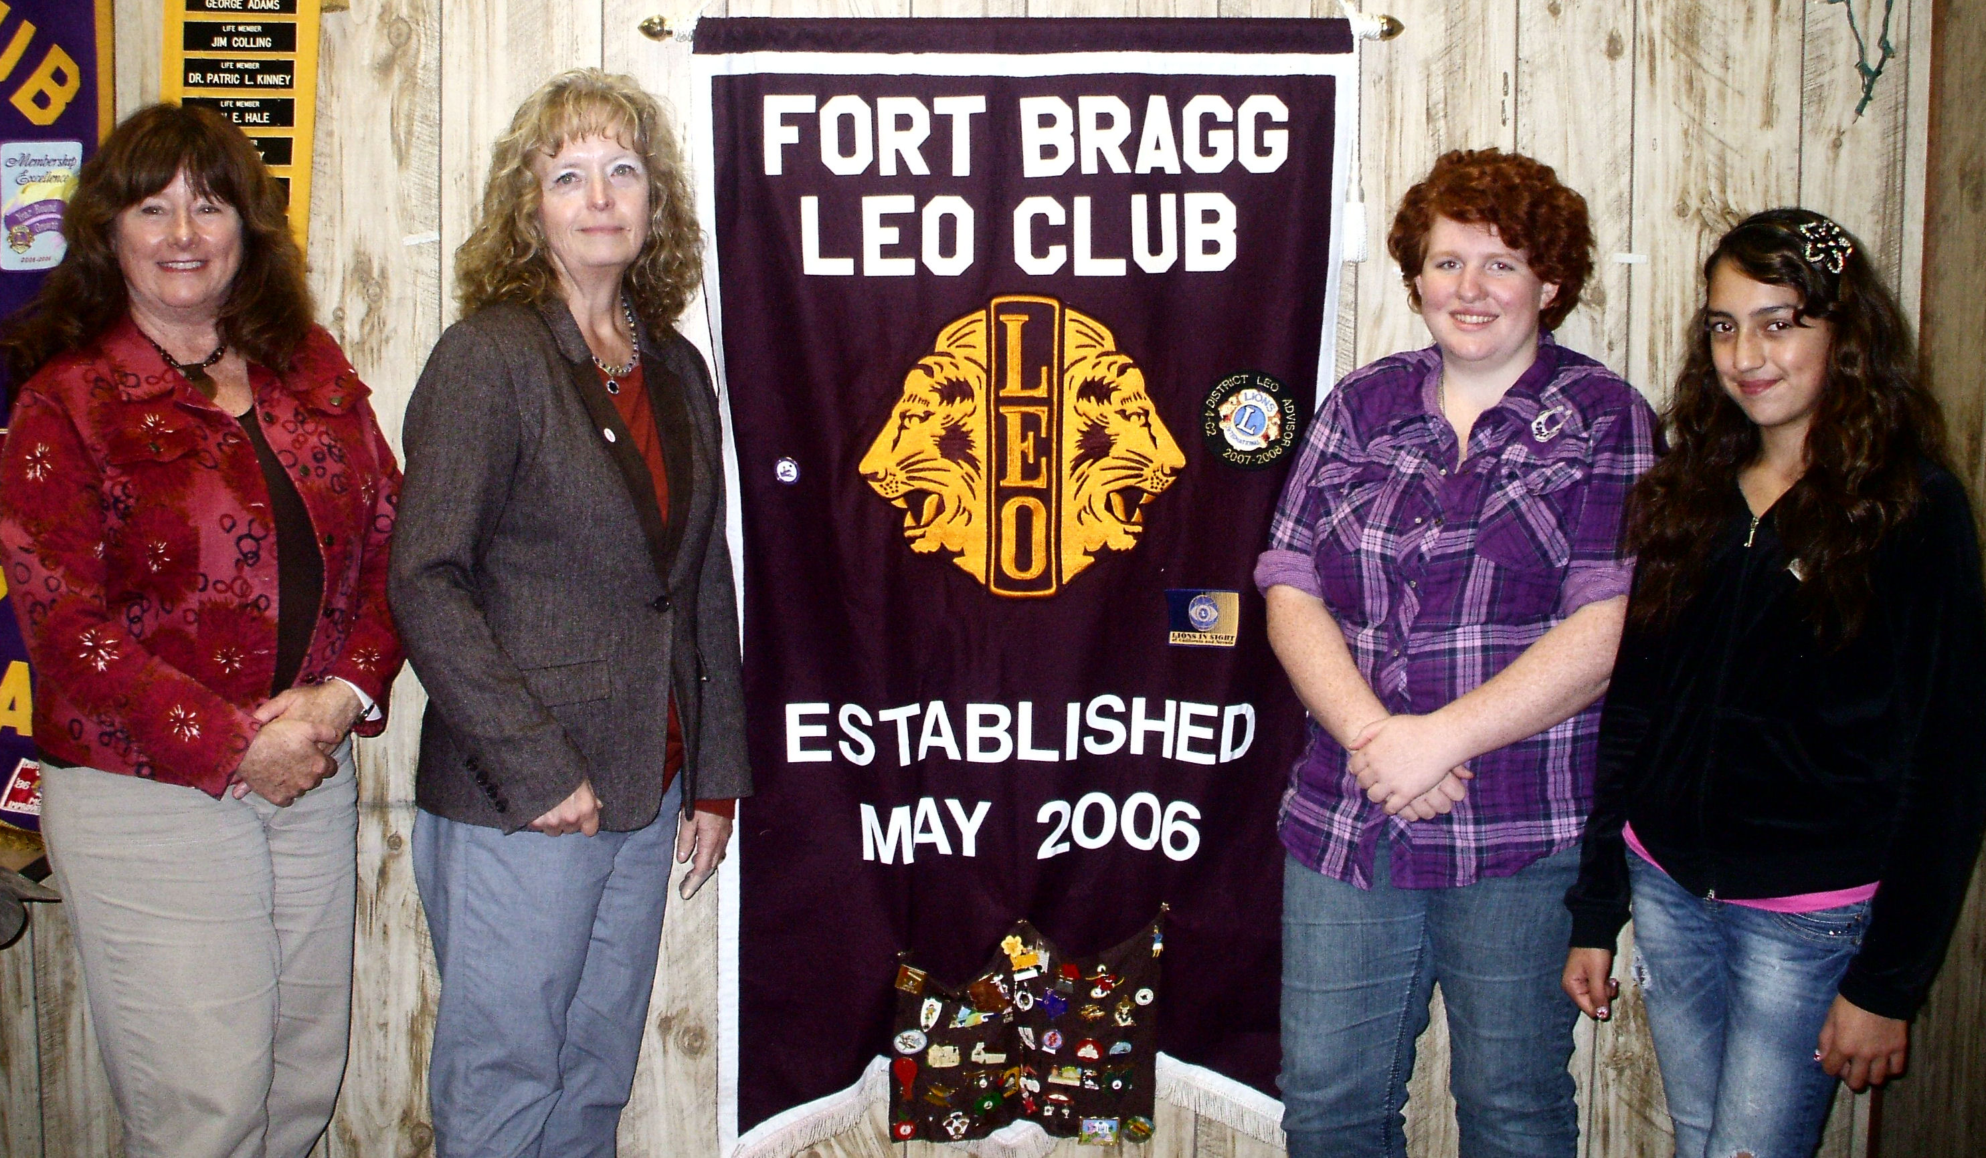
The Fort Bragg Leo Club donated $1,500 for 3 years to the Fort Bragg Unified School District to help start a pilot program for Anti-Bullying. It was so successful, the State of California Department of Education now covers the expense of the program

Slide 26
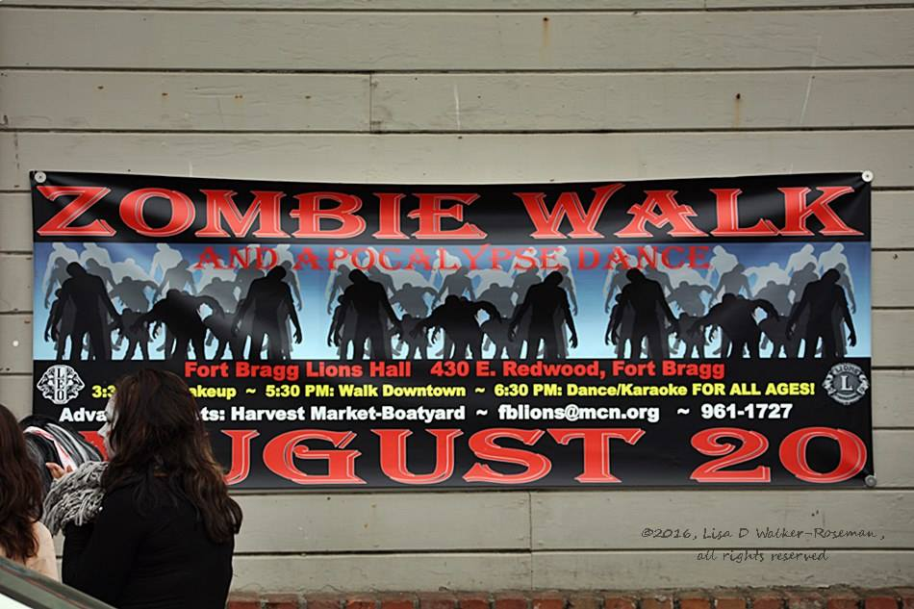
The Fort Bragg Leos had a Leo member that was diagnosed with Leukemia. This began their fight against childhood Cancer – and now their annual Zombie walk. They identify a child/teen with Cancer, and donate all proceeds to the family to help with travel expenses to and from the Bay Area

Slide 27
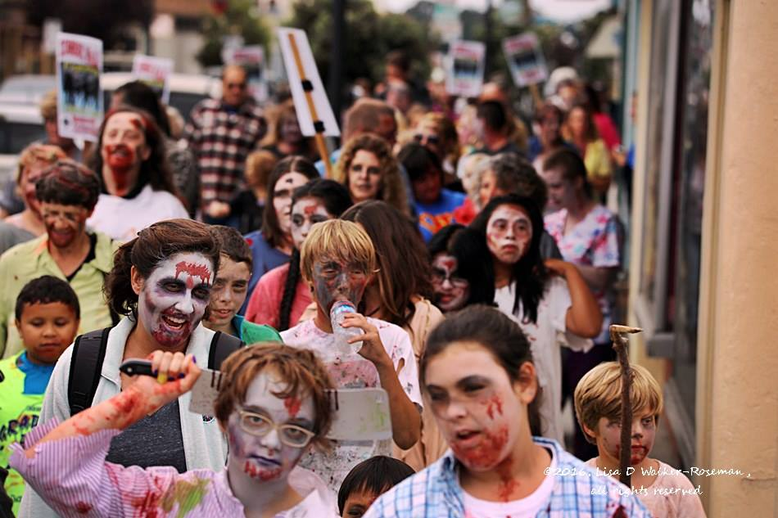

Slide 28
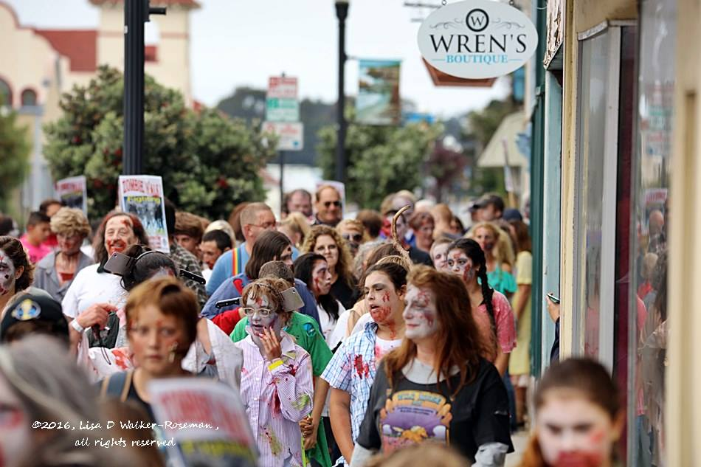

Slide 29
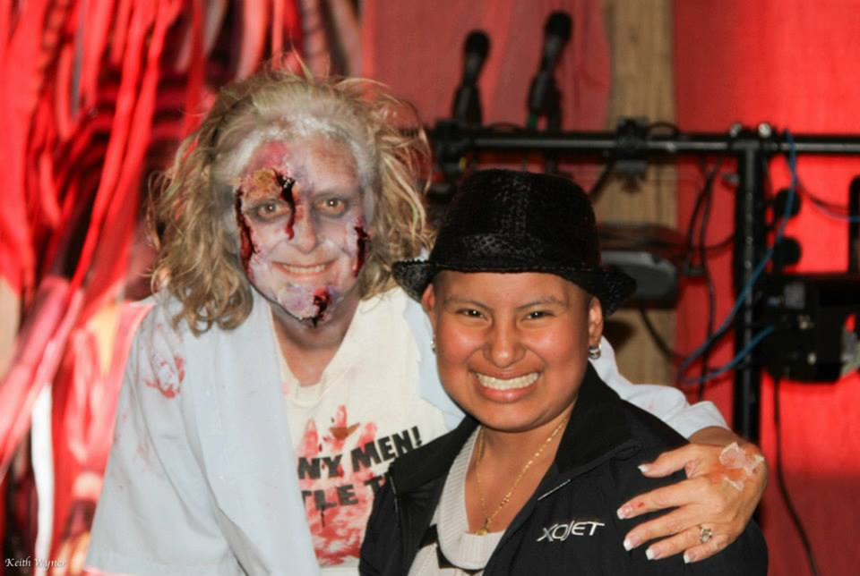
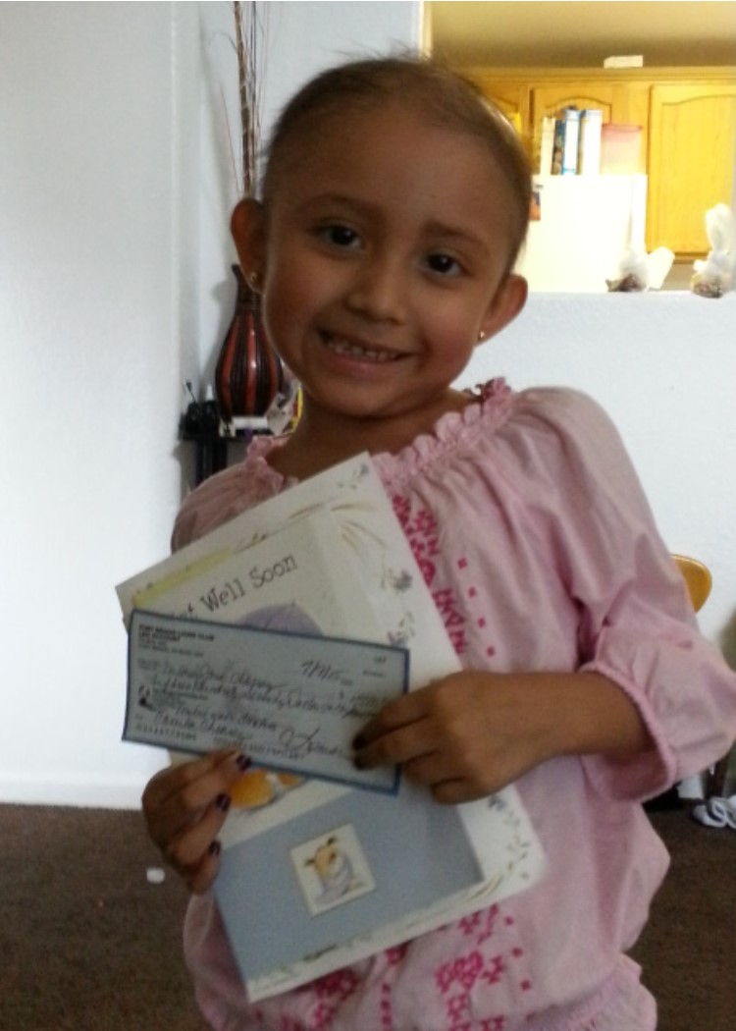
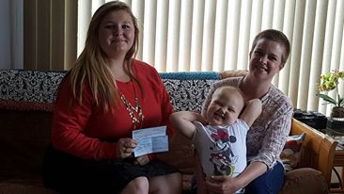
$3,000
$4,700
$7,200

Slide 30
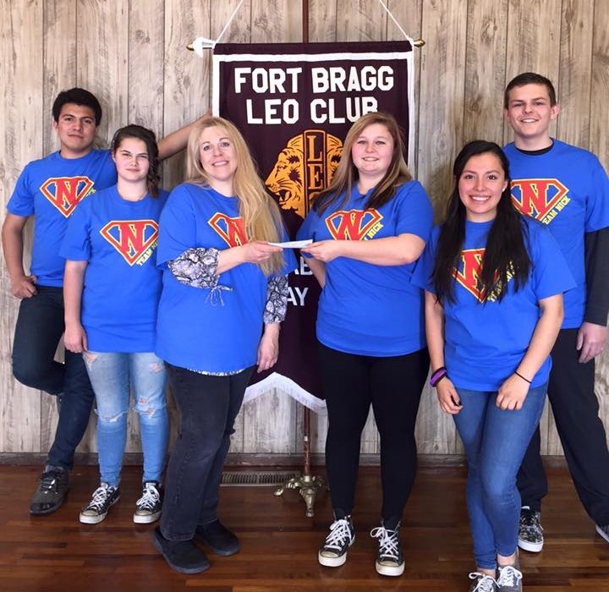
The Fort Bragg Leo Club is now partnering with “Team Nick” and his fight against Childhood Cancer. They donated $500 for tee shirts to “Team Nick”. Team Nick helps the Leos identify children with Cancer for their annual Zombie Walk

Slide 31
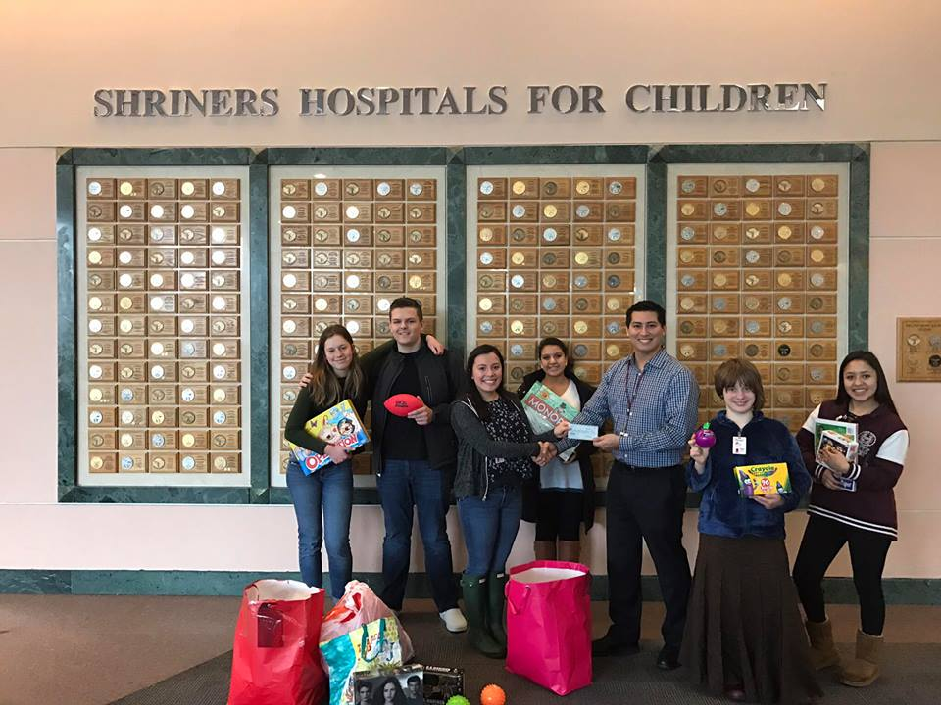
The Fort Bragg Leos donated $1,500 plus over $300 in toys and gifts personally delivering to the Shriners Hospital for Children

Slide 32
For more information about Leo Clubs, visit: http://members.lionsclubs.org/EN/leos/
For more information about the Fort Bragg Leo Club, visit:
http://www.fortbragglionsclub.org/Leos.html

